Slide 1

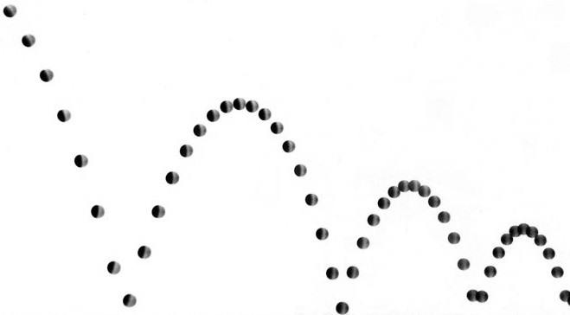





2
Kinematics of Projectile Motion
Projectile Motion
A projectile is an object that moves in two dimensions under the influence of only gravity. The acceleration is that of free fall:
The trajectory of a projectile is a parabola, which you can see in the below time-lapse photograph of a bouncing ball.
A motion diagram shows that this trajectory is due to the vertically downward acceleration:
Coordinate System
Although where you put the origin is arbitrary, it is standard to arrange your coordinate system for projectile motion such that the y axis is vertical with positive upward and the x axis is horizontal with positive to the right. We’ll assume that the projectile is launched to the right at an angle of θ with initial speed v₀ as shown below.
In this coordinate system, the initial velocity ${\vec{v}}_{0}$ has components
The components of the acceleration $\vec{a}$ are
y
v_{0y}
θ
x
v_{0x}
Model: Projectile Motion
With the coordinate system described above, the mathematical model for an object undergoing projectile motion is:
Horizontal Motion
Constant velocity
Position
Velocity
Vertical Motion
Constant acceleration – free fall
Position
Velocity
Mechanics
Joseph D. MacMillan | Licensed under CC BY-NC-SA 4.0.

